Slide 1

Ethical Hacking Internship Project Submission
Name: Nishat Afroz
Internship: Ethical Hacking Internship at iStudio
Duration: 1 February – 1 Month Task 1 & Task 2 Submission

Slide 2
Introduction
This project was assigned as part of the Ethical Hacking Internship program. The objective of this project is to understand web application vulnerabilities and perform basic security testing in a controlled environment.

Slide 3
Task 1 Overview (XSS Labs)
Task 1 required solving 5 Cross-Site Scripting (XSS) labs from PortSwigger Web Security Academy.
Objective:
Understand XSS vulnerability
Learn how web input validation works
Practice solving real-world security labs

Slide 4
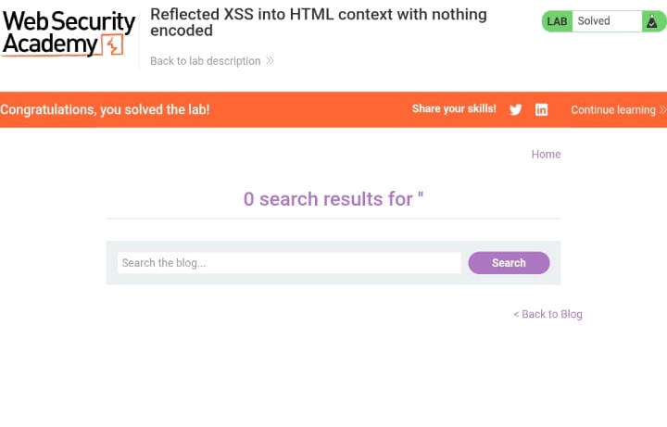
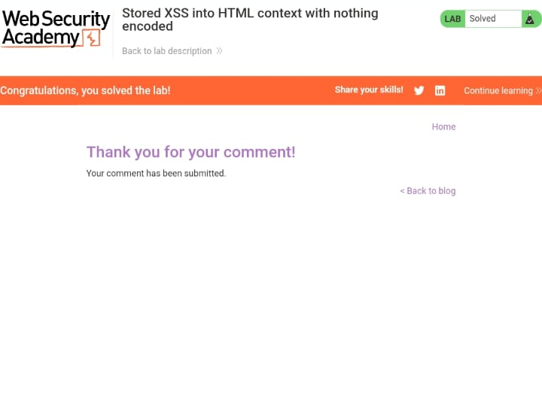
Task 1 Lab Results
Figure 1: Lab 2 solved
Figure 2: Lab 2 solved

Slide 5
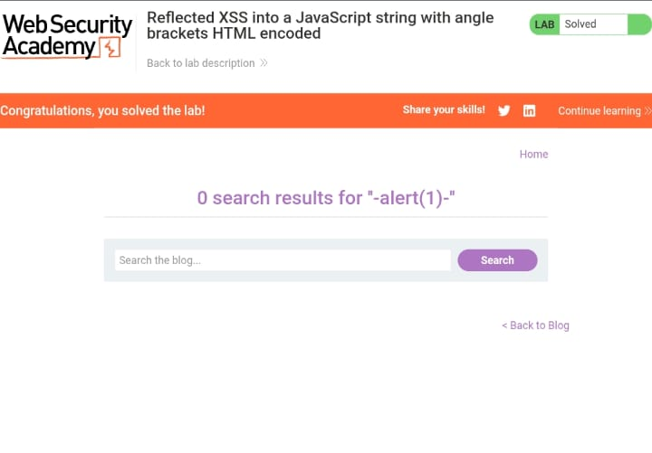
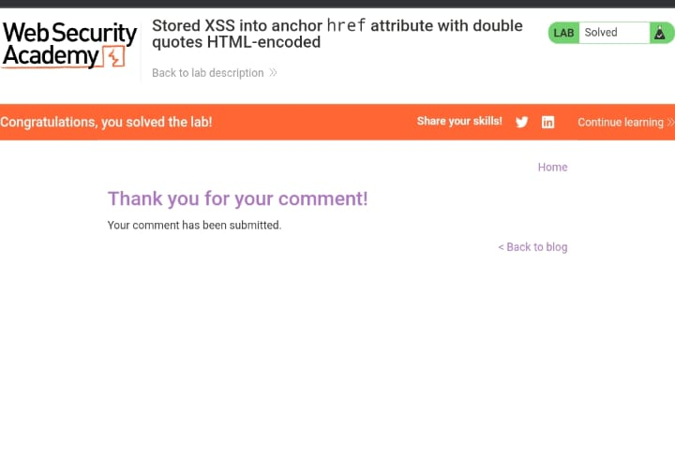
Figure 4: Lab 4 solved
Figure 3: Lab 3 solved

Slide 6
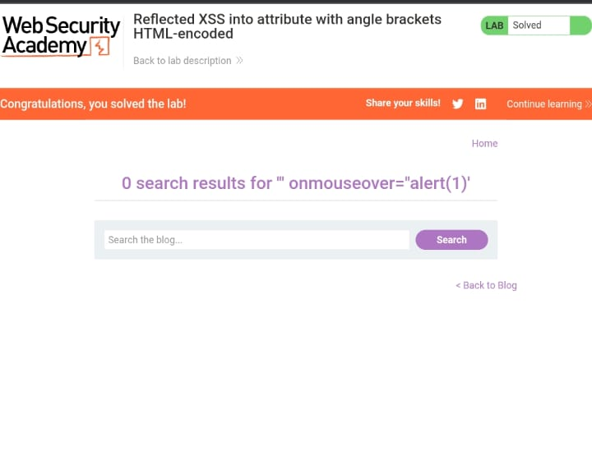
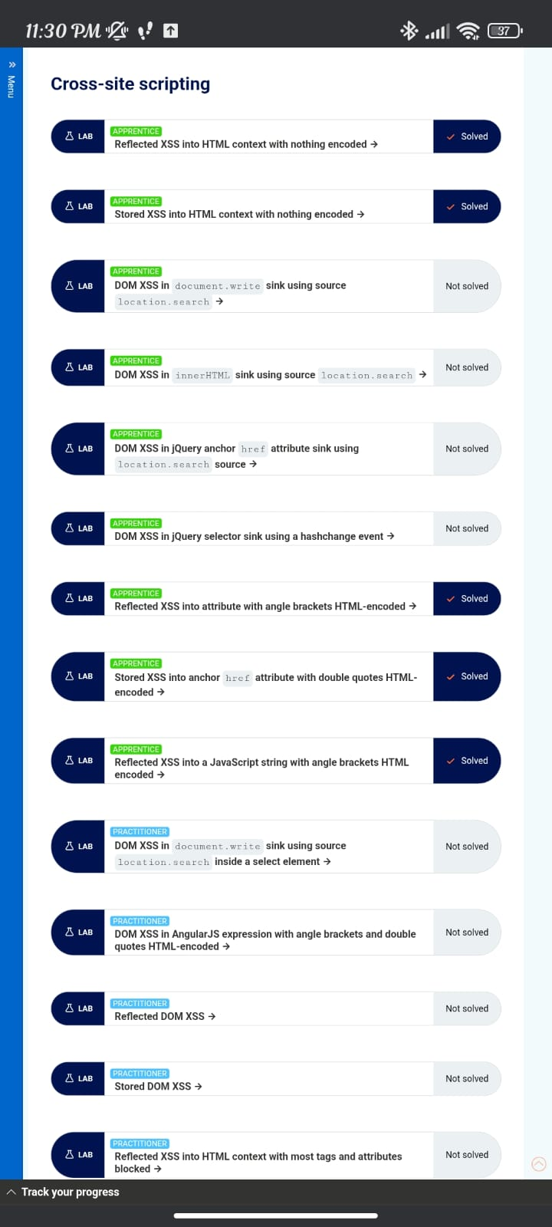
Figure 3: Lab 3 solved

Slide 7
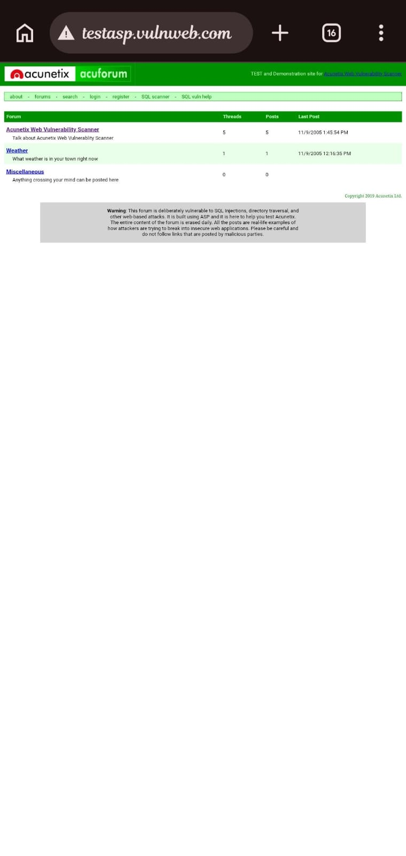
What I Learned in Task 1
How XSS vulnerabilities occur
Importance of input validation
How malicious scripts can run in a browser
Basics of secure web development
Figure 6: Warning message displayed on testasp.vulnweb.com

Slide 8
Conclusion
Through this project, I gained practical knowledge of:
Cross-Site Scripting (XSS)
Web application vulnerabilities
Security testing basics
Importance of secure coding practices.
This internship helped me understand how vulnerabilities are identified in a controlled lab environment

